Slide 1
“TO-DO PLANNER”
Task - 1

Slide 2

TO-DO PLANNER
Smart to do list is an open source to-do manager specially designed to help users manage their tasks and projects without going through the process of typing.
LMS Username | Name | Batch
2113a52191 | RajKamal M | A52
2113a52174 | Dinesh V | A52
2113a52182 | Luckysan J | A52
2113a52187 | MohitRahul A R | A52

Slide 3
Task - 1
Creation of SRS & Github
Create SRS : “TO DO PLANNER”
Creation & Set-up of Github account
Creation & Hands-on to various commands of Git Bash
Evaluation Metric:
100% Completion of the above tasks
Learning Outcome
Get to know about different lifecycle models.
Understanding importance and how to create an SRS
Knowing various commands of Github
Understanding agile and scrum management techniques for efficient product development

Slide 4
BENEFITS
As a plain to do manager, user’s tasks can be saved and reminded in hierarchical form.
While, as a professional to do manager, timers are set which can aid to remind of the meetings schedules and also of the approaching deadlines. here are many benefits of To Do lists.
Helping you prioritize your time to helping you remember what it is you meant to do!
Manage tasks effectively.
You can see all of the items at a glance and prioritize, what most needs to be done according to timelines and importance.

Slide 5
SRS for “Audience"
INTENDED AUDIENCE
• Developers who want to extend the program with new features.
• Testers who are interested in discovering possible flaws of the program and want to report them for improvement.
• All users of the program, who are interested in being informed about the capabilities, which smart to-do list, gives to them

Slide 6
SRS for “TODO PLANNER"
Functional Requirements
Task in the Menu
New Task Creation
Adding description to the task
New Sub Task Creation
Edit Task
Move Task
Delete Task
Mark Task Completed
Mark Task In-completed
Start Timer
Pause Timer
New Note
Edit Note Delete Note

Slide 7
SRS for “TODO PLANNER "
Non Functional Requirements
Performance Requirement
Safety and Security Requirement
Software Quality Attributes

Slide 8
SRS for “TODO PLANNER"
PRODUCT FUNCTIONALITY
The Intelligent ToDo System provides a simple mechanism for users to organize their daily routine by saying something like “Remind me to bring vegetables at 2pm” and it will smartly set the reminder and will prompt it to the user
Set a reminder to organize your day
Set an alarm for meetings, milestones etc
Suggests time for the completion of task
Prioritize the most important task first
Constantly reminding you to complete pending tasks (if any)

Slide 9
SRS for “TODO PLANNER "
Software Requirements
SQL Server :
SQL stands for Structured Query Language . SQL is a database computer language designed for managing data in relational database management systems (RDBMS), and originally based upon relational algebra and calculus. Its scope includes data insert, query, update and delete, schema creation and modification , and data access control.
MongoDB :
MongoDB is a source-available cross-platform document-oriented database program. Classified as a NoSQL database program, MongoDB uses JSON-like documents with optional schemas.

Slide 10
SRS for “TODO PLANNER "
Hardware Requirements
TODO PLANNER works without communicating at all, with any external hardware device. Only a network interface card is required, so that TODO PLANNER can connect to Internet

Slide 11
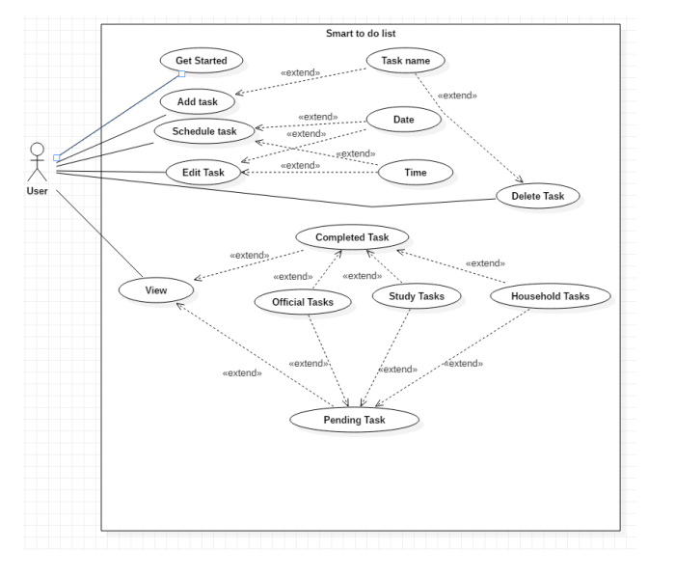
USE CASE VIEW

Slide 12
Step-Wise Description
Initial Requirements Collection
Start of DB structure
Start of Front End Development
End of DB structure
Completion of Front End
Start of Back End
Complete entire app
Test of App
Deployment
Summary of your task
Each task is scheduled among the members of the team according to their interest

Slide 13
Assessment Parameter
Gather requirements for the project
add Readme.md file with description of the project
Prepare database design schemas
Check-List
Commit all changes with "first commit"
Get your initial project Structure ready
create a repository on github realted to project
Initiate a git repository
Push your changes to github

Slide 14
Submission Github
Github Link

